Slide 2
Lecture 1 : Introduction
MANAGERS IN THE WORKPLACE
1–<number>

Slide 3
What Is Management?
Management involves coordinating and overseeing the work activities of others so that their activities are completed efficiently and effectively.
Copyright © 2010 Pearson Education, Inc. Publishing as Prentice Hall
1–<number>

Slide 4

Who Are Managers?
Manager
  Someone who coordinates and oversees the work of other people so that organizational goals can be accomplished.

Slide 5
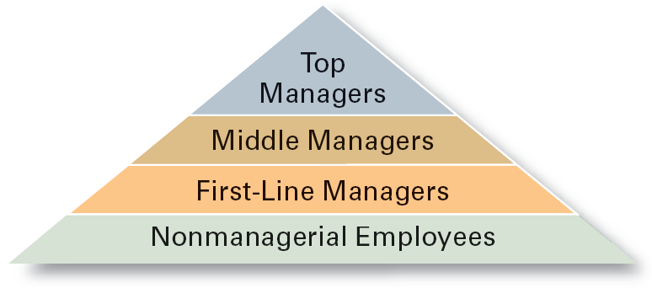
Exhibit 1–1 Managerial Levels
1–<number>

Slide 6
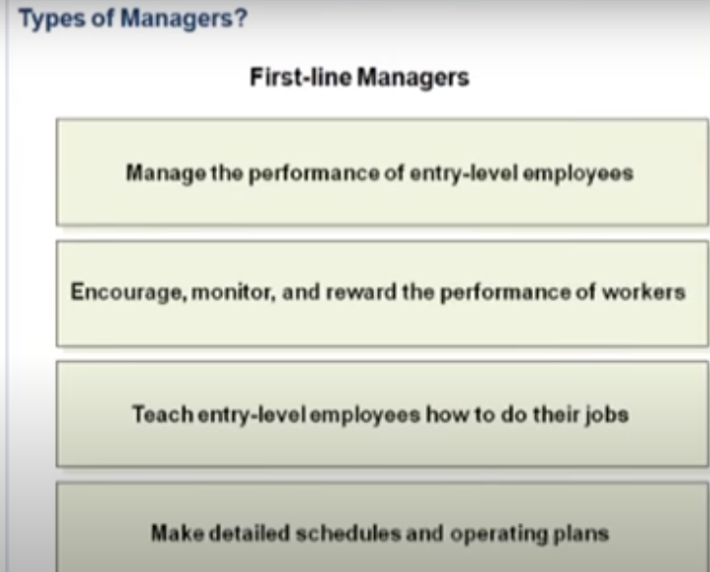

Slide 7
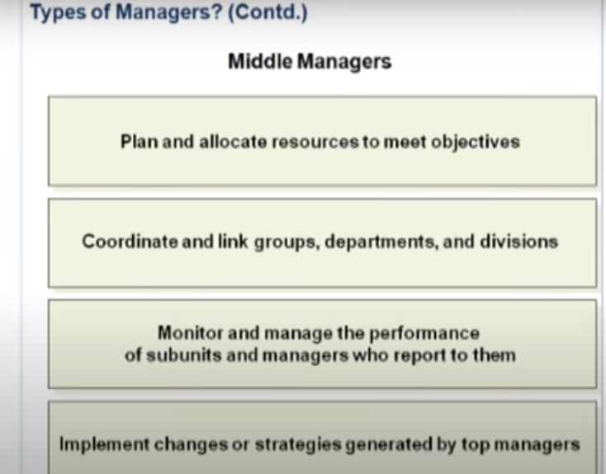

Slide 8
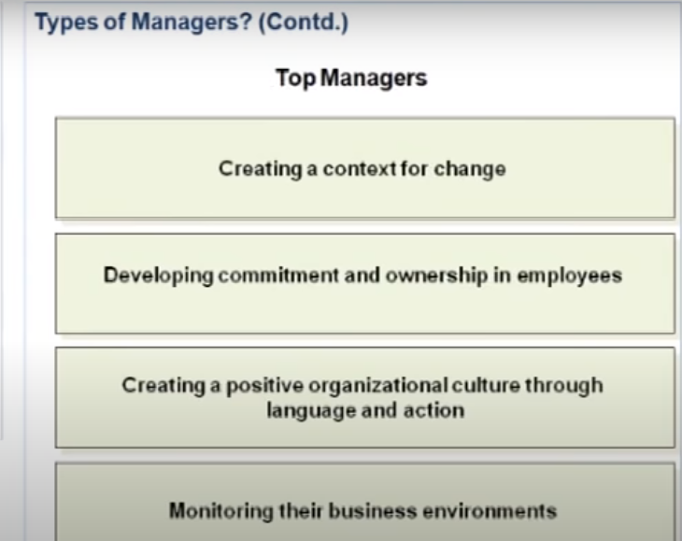

Slide 9
Classifying Managers
First-line Managers
  Individuals who manage the work of non-managerial employees.
  First-line managers may becalled supervisors or even shift managers, district managers, department managers, or office managers.
Middle Managers
  Individuals who manage the work of first-line managers.
  They may have titles such as regional manager, project leader, store manager, or division manager.
Top Managers
  Individuals who are responsible for making organization-wide decisions and establishing plans and goals that affect the entire organization.
  These individuals typically have titles such as executive vice president, president, managing director, chief operating officer, or chief executive officer.
1–<number>

Slide 10

What Is Management?
Managerial Concerns
  Efficiency
    “Doing things right”
      Getting the most output for the least inputs
  Effectiveness
    “Doing the right things”
      Attaining organizational goals
1–<number>

Slide 11
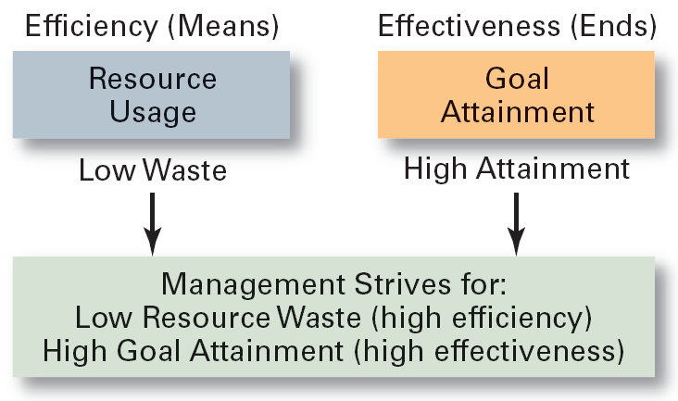
Exhibit 1–2 Effectiveness and Efficiency in Management
1–<number>

Slide 12
What Managers Do?
Three Approaches to Defining What Managers Do.
  Functions they perform.
  Roles they play.
  Skills they need.
Copyright © 2010 Pearson Education, Inc. Publishing as Prentice Hall
1–<number>

Slide 13
What Do Managers Do?
Functional Approach
  Planning
    Defining goals, establishing strategies to achieve goals, developing plans to integrate and coordinate activities.
  Organizing
    Arranging and structuring work to accomplish organizational goals.
  Leading
    Working with and through people to accomplish goals.
  Controlling
    Monitoring, comparing, and correcting work.
1–<number>

Slide 14
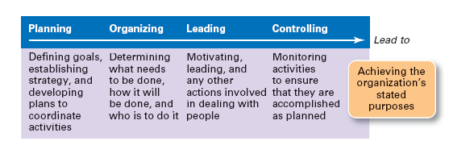
Exhibit 1–3 Management Functions
1–<number>

Slide 15
What Managers Do?
Roles Manager’s Play
  Roles are specific actions or behaviors expected of a manager.
  Mintzberg identified 10 roles grouped around interpersonal relationships, the transfer of information, and decision making.
Copyright © 2010 Pearson Education, Inc. Publishing as Prentice Hall
1–<number>

Slide 16

What Do Managers Do? (cont’d)
Management Roles Approach (Mintzberg)
  Interpersonal roles
    Figurehead, leader, liaison
  Informational roles
    Monitor, disseminator, spokesperson
  Decisional roles
    Disturbance handler, resource allocator, negotiator
1–<number>

Slide 17
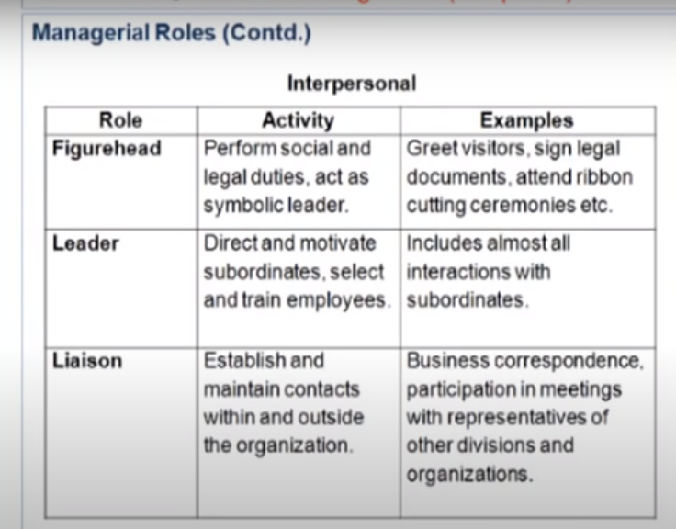

Slide 18
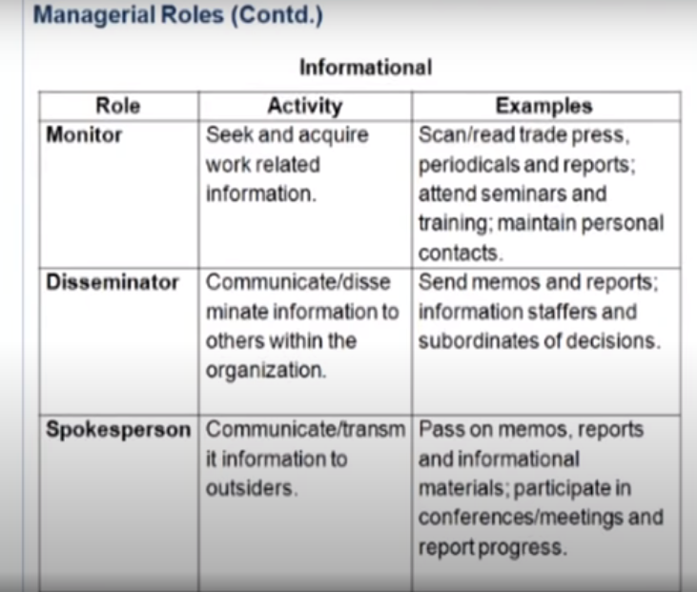

Slide 19
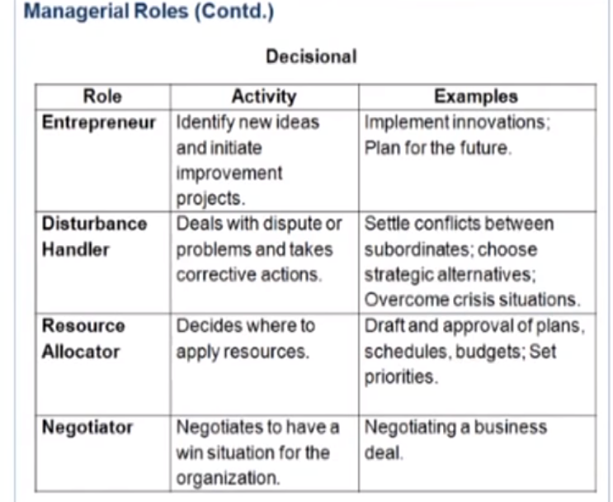

Slide 20
What Do Managers Do? (cont’d)
Skills Approach
  Technical skills
    Knowledge and proficiency in a specific field
  Human skills
    The ability to work well with other people
  Conceptual skills
    The ability to think and conceptualize about abstract and complex situations concerning the organization
1–<number>

Slide 21
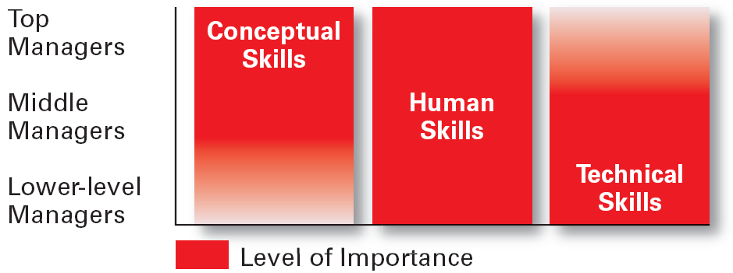
Exhibit 1–5 Skills Needed at Different Management Levels
1–<number>

Slide 22
Exhibit 1–6 Conceptual Skills
Using information to solve business problems
Identifying of opportunities for innovation
Recognizing problem areas and implementing solutions
Selecting critical information from masses of data
Understanding of business uses of technology
Understanding of organization’s business model
Source: Based on American Management Association Survey of Managerial Skills and Competencies, March/April 2000, found on AMA Web site (www.ama.org), October 30, 2002.
1–<number>

Slide 23
Exhibit 1–6 Communication Skills
Ability to transform ideas into words and actions
Credibility among colleagues, peers, and subordinates
Listening and asking questions
Presentation skills; spoken format
Presentation skills; written and/or graphic formats
Source: Based on American Management Association Survey of Managerial Skills and Competencies, March/April 2000, found on AMA Web site (www.ama.org), October 30, 2002.
1–<number>

Slide 24
Exhibit 1–6 Interpersonal Skills (cont’d)
Coaching and mentoring skills
Diversity skills: working with diverse people and cultures
Networking within the organization
Networking outside the organization
Working in teams; cooperation and commitment
Source: Based on American Management Association Survey of Managerial Skills and Competencies, March/April 2000, found on AMA Web site (www.ama.org), October 30, 2002.
1–<number>

Slide 25
Exhibit 1–6 Effectiveness Skills
Contributing to corporate mission/departmental objectives
Customer focus
Multitasking: working at multiple tasks in parallel
Negotiating skills
Project management
Reviewing operations and implementing improvements
Source: Based on American Management Association Survey of Managerial Skills and Competencies, March/April 2000, found on AMA Web site (www.ama.org), October 30, 2002.
1–<number>

Slide 26
Exhibit 1–6 Effectiveness Skills (cont’d)
Setting and maintaining performance standards internally and externally
Setting priorities for attention and activity
Time management
Source: Based on American Management Association Survey of Managerial Skills and Competencies, March/April 2000, found on AMA Web site (www.ama.org), October 30, 2002.
1–<number>

Slide 27
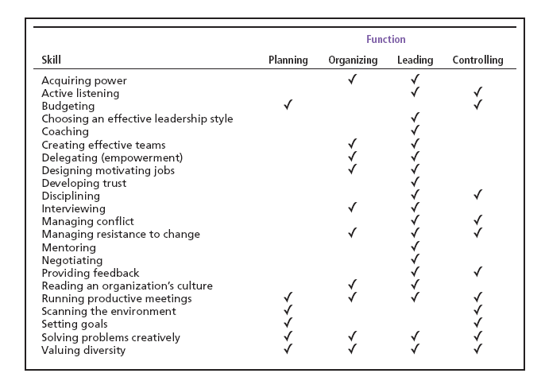
Exhibit 1–7 Management Skills and Management Function Matrix
1–<number>

Slide 28
How The Manager’s Job Is Changing
The Increasing Importance of Customers
  Customers: the reason that organizations exist
    Managing customer relationships is the responsibility of all managers and employees.
    Consistent high quality customer service is essential for survival.
Innovation
  Doing things differently, exploring new territory, and taking risks
    Managers should encourage employees to be aware of and act on opportunities for innovation.
1–<number>

Slide 29
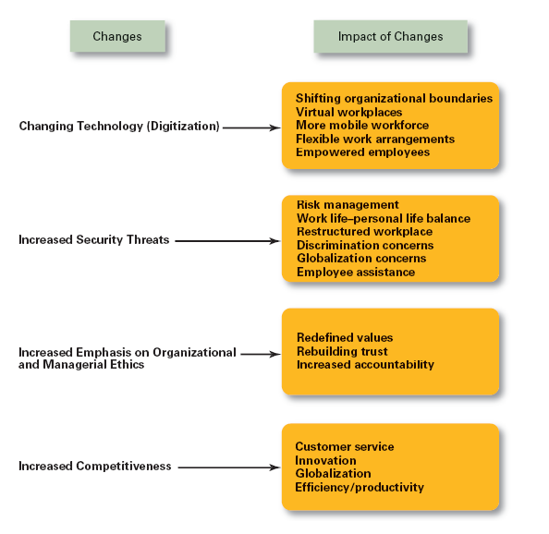
Exhibit 1–8
Changes Impacting the Manager’s Job
1–<number>

Slide 30
What Is An Organization?
An Organization Defined
  A deliberate arrangement of people to accomplish some specific purpose (that individuals independently could not accomplish alone).
Common Characteristics of Organizations
  Have a distinct purpose (goal)
  Composed of people
  Have a deliberate structure
1–<number>

Slide 31
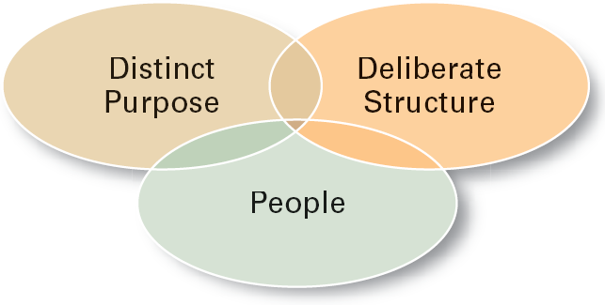
Exhibit 1–9 Characteristics of Organizations
1–<number>

Slide 32
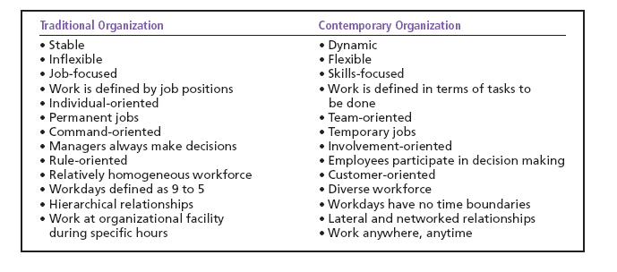
Exhibit 1–10 The Changing Organization
1–<number>

Slide 33
Why Study Management?
The Value of Studying Management
  The universality of management
    Good management is needed in all organizations.
  The reality of work
    Employees either manage or are managed.
  Rewards and challenges of being a manager
    Management offers challenging, exciting and creative opportunities for meaningful and fulfilling work.
    Successful managers receive significant monetary rewards for their efforts.
1–<number>

Slide 34
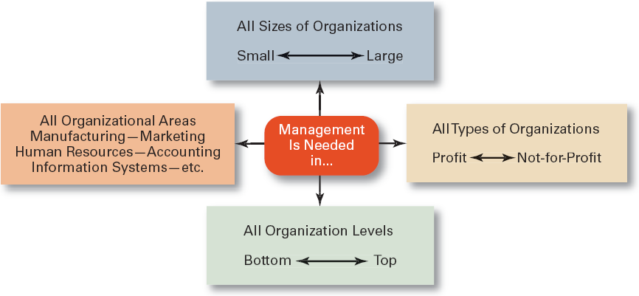
Exhibit 1–11 Universal Need for Management
1–<number>

Slide 35
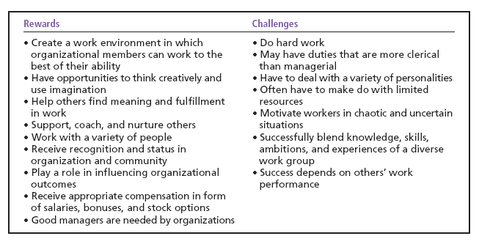
Exhibit 1–12 Rewards and Challenges of Being A Manager
1–<number>

Slide 36
Terms to Know
manager
first-line managers
middle managers
top managers
management
efficiency
effectiveness
planning
organizing
leading
controlling
management roles
interpersonal roles
informational roles
decisional roles
technical skills
human skills
conceptual skills
organization
universality of management
1–<number>

